Slide 1
Labeling maintenance
Maintain labeling template
Retrain the Word2Vec model on colab

Slide 2


Labeling
What is the labeling used for? And how does it work?
Speaker Label | Text
Speaker 0 | Hello
Speaker 1 | Hello good afternoon
Word2Vec Model
(Word Mover's Distance)
SD: Speaker N
Agent
STT: Audio Text
Checklist
(Template)
Customer
Hello, this is … calling from UOB
NRIC/Passport number
Your education qualification
Length of investment required from you
……

Slide 3
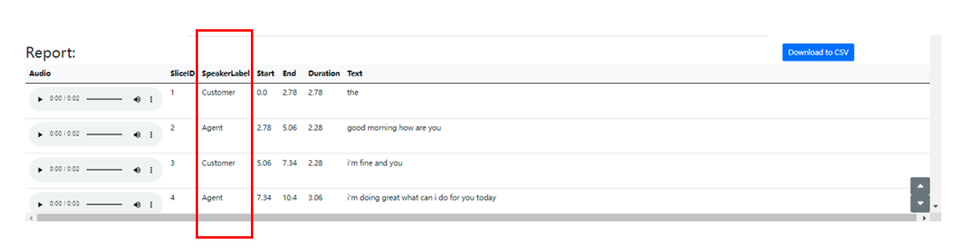
Labeling
What is the labeling used for?
Labeling is to identify which of Speaker 0 and Speaker 1 distinguished by SD module is the Agent and which is the Customer. Distinguishing Agent and Customer is helpful for subsequent analysis of a series of use cases.

Slide 4
Labeling
How does it work?
After we have the discrimination results of Speaker 0 and Speaker 1 of SD and the text results of STT, we use the Agent speech template (In current case called 'checklist') given by the company to calculate the similarity between the speech template and the text of speakers respectively. The more similar speaker is labeled as Agent, and the other is labeled as Customer.
In a more theoretical process, we will convert the text from Speaker 0 and Speaker 1 and the speech template into vectors through the pre-trained Word2Vec model and calculate the similarity through Word Mover's Distance. The smaller the distance, the more similar the text is. If the text is more similar to the Agent speech template, label the speaker as Agent.

Slide 5
Maintain
When does it need to be maintained?
At present, the common phrases used by Agent in the application scenarios of Mystery Shopping and Call Center have been added to checklist.txt.
If you change to a new business scenario, it is best to modify checklist.txt and retrain the Word2Vec model in colab (very convenient and fast(a few seconds)).
If maintenance is required, first maintain the checklist.txt, and then use the new checklist.txt to retrain the Word2Vec model.

Slide 6
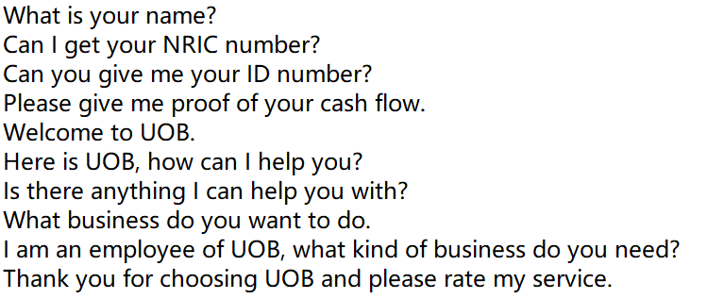
Maintain labeling template
Path: main/pretrained-model/label/checklist.txt
checklist.txt example:

Slide 7
Maintain labeling template
checklist.txt example:
How to maintain?
You can directly add the commonly used text of Agent（not Customer) in this txt, the more data the better. Then put the checklist.txt under the path: main/pretrained/model/label/checklist.txt
Next, train a new Word2Vec model with this new checklist.txt!

Slide 8
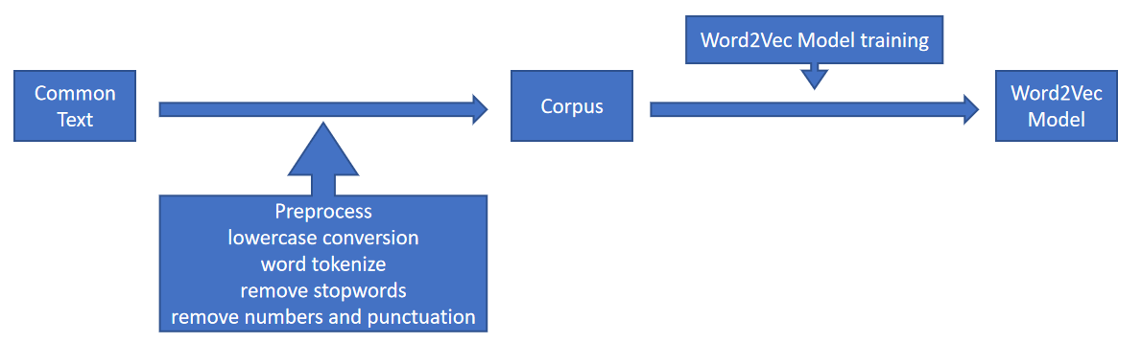
Retrain the Word2Vec model on colab
Code: in the ucloud folder Documentation/Labeling model maintain(retrain)
Labelling_w2vtrainmodel.ipynb (train on colab) (recommend)
labelling_w2vtrainmodel.py (train on prem)
Workflow:

Slide 9
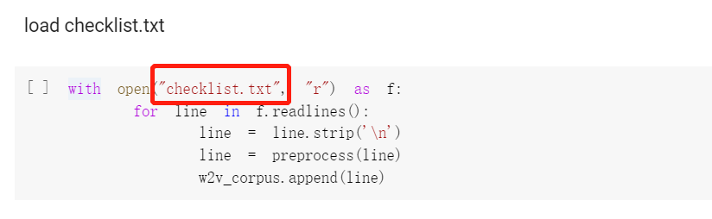
Retrain the Word2Vec model on colab
Need to prepare:
checklist.txt with common text of Agent
How to use code:
1. Put the path of checklist.txt here.

Slide 10
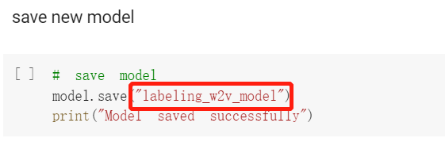
Retrain the Word2Vec model on colab
How to use code:
2. Put the path and name of the new model here.
As shown in the figure below, if only the name is entered, the model will be stored in the default path.
3. The rest of the code can be run directly without changes, and training on colab is fast.

